Slide 1
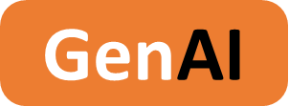

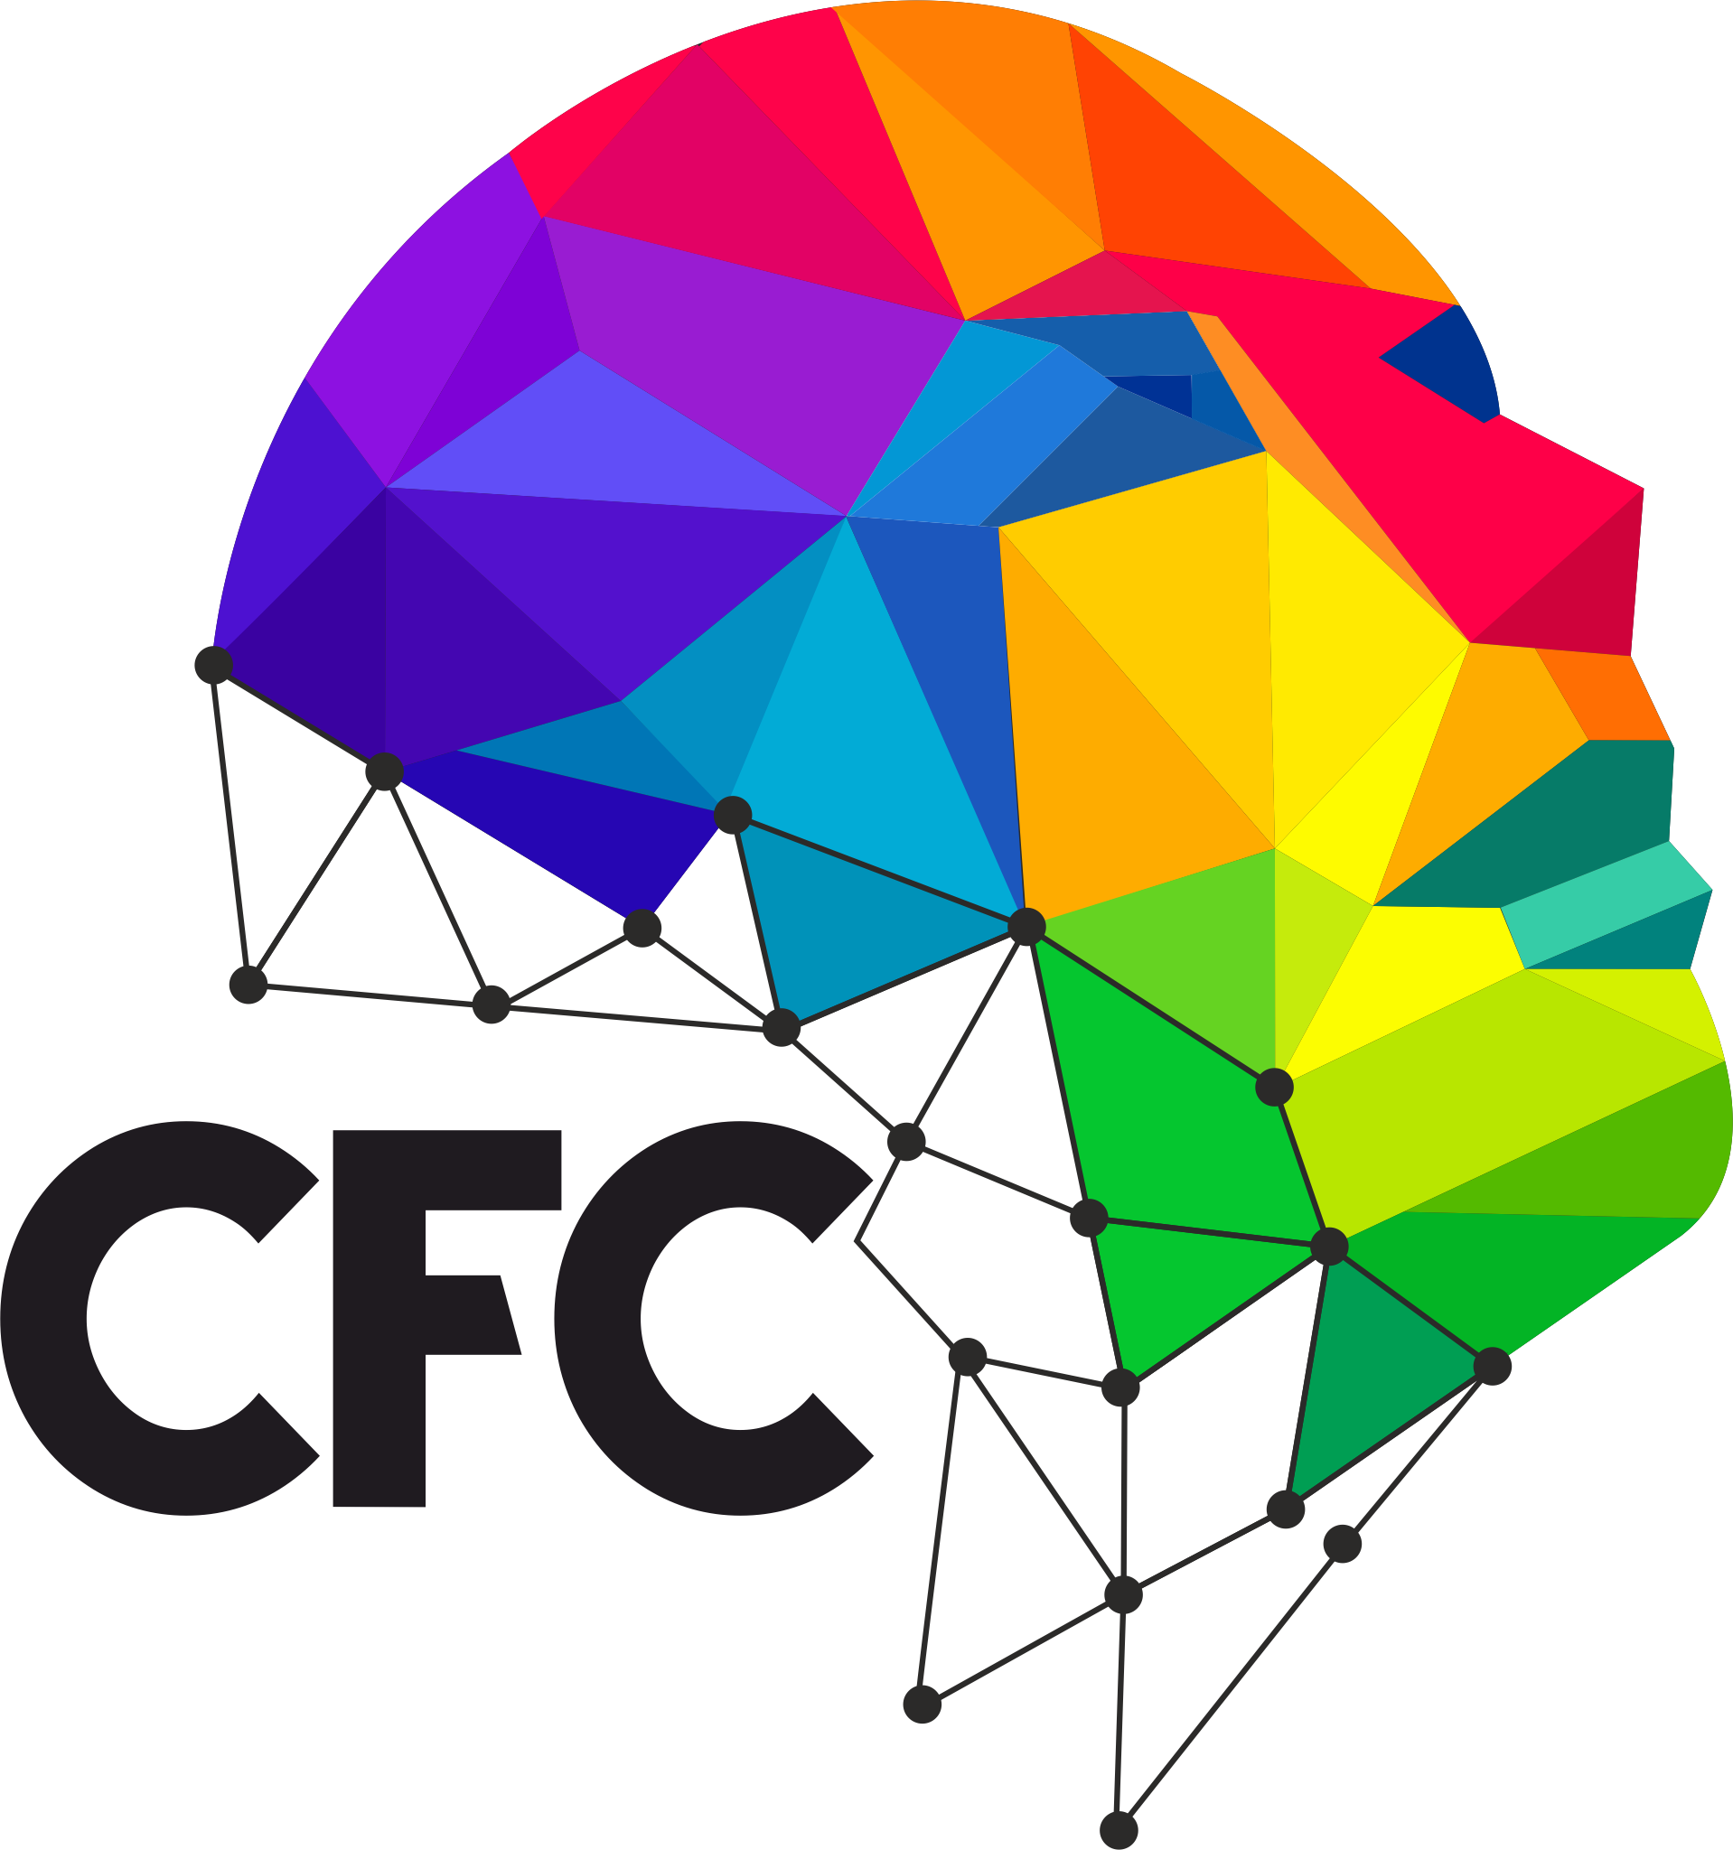
AI based crop
monitoring system 2024 - 2025
Nurture smart, harvest better.
GenAI-2024-2025-B2-316
GenAI-2024-2025-B2

Slide 2
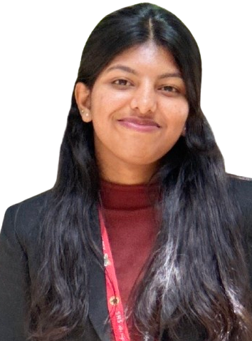
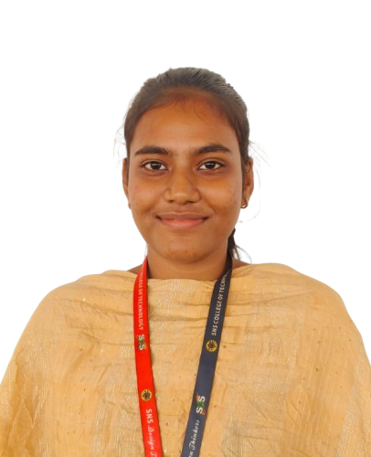
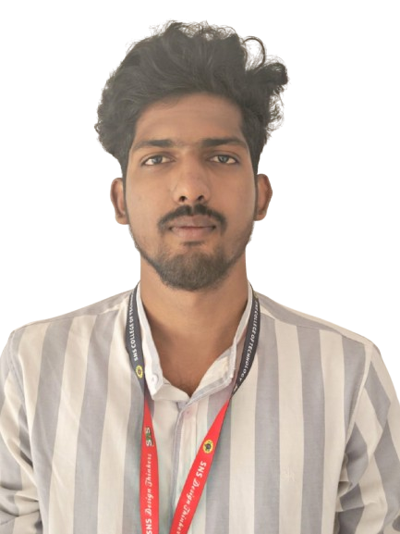
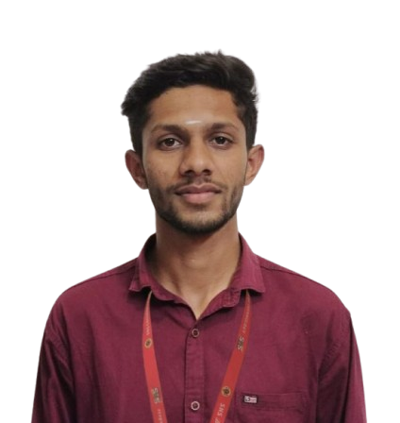
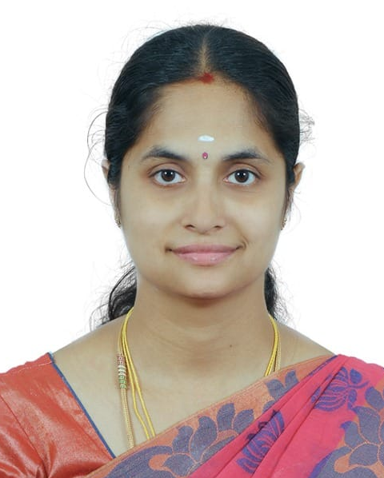
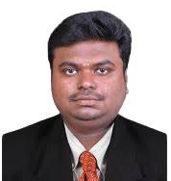
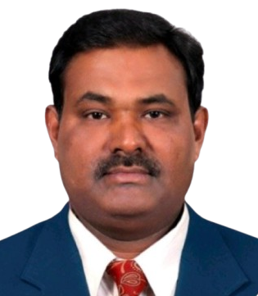
AI based crop monitoring system
Team Information
GenAI-2024-2025-B2-316
Harini T.A
Harshini K.S
Kathiravan B
Karan S
Student Team
IV-B.E, Electrical & Electronics Engineering
SNSCT
Team Lead, Developer
IV-B.E, Electrical & Electronics Engineering
SNSCT
Research
IV-B.E, Electrical & Electronics Engineering
SNSCT
Developer
IV-B.E, Electrical & Electronics Engineering
SNSCT
Research
Ms. Kavitha D
Mr. Bharath S
Dr. Ramakrishnan C
Faculty
DT Mentor
Technology Mentor
Project Guide

Slide 3
AI based crop monitoring system
Project Overview
GenAI-2024-2025-B2-316
Requirement / Problem statement
Crop diseases often go undetected until significant damage occurs, leading to reduced yields. Traditional methods of monitoring are slow and labor-intensive. There is a need for an automated, real-time solution to detect crop diseases early and provide farmers with timely recommendations to protect their crops and improve yields.
Description
This AI-based Crop Monitoring System uses camera modules, microcontrollers, and machine learning to detect crop diseases early and provide actionable treatment recommendations. It helps farmers reduce crop loss, improve yield, and save time by automating disease detection and analysis. The system benefits individuals, communities, and industries by enhancing food security, promoting sustainable agriculture, and optimizing farming practices.
Scope
GenAI | AI
The AI-based Crop Monitoring System uses camera modules and machine learning to detect crop diseases early, providing real-time alerts and treatment recommendations. It helps farmers improve yield, reduce loss, and promote sustainable farming practices. The system is scalable, AI-integrated, and adaptable to various crops and farming environments.
AI detects diseases through image analysis, provides real-time recommendations, learns from user data, and predicts future crop health trends.
Key factors & features
Target Audience
Domain
AI disease detection, real-time alerts, cloud storage, scalable, mobile access, continuous learning, and sustainable farming support.
Farmers, Agricultural experts & consultants, Agritech companies, Government Agencies & NGOs
Agricultural Technology
Artificial Intelligence
Machine Learning

Slide 4
AI based crop monitoring system
Project Features
GenAI-2024-2025-B2-316
Project Features
Comprehensive Data Integration
Combines environmental (rainfall, temperature, soil nutrients) and economic (yield, production) data.
Data sourced from Government websites and Kaggle.
Multiple Machine Learning Algorithms
Uses Decision Trees, SVM, Logistic Regression, and Random Forest.
Random Forest model gives highest accuracy (99%).
Tailored Crop and Fertilizer Recommendations
Suggests optimal crop types based on location, soil, and climate data.
Provides fertilizer recommendations based on soil nutrient deficiencies.
User-Friendly Interface
Simple input interface for farmers to enter their data.
Data-Driven Insights
Helps farmers make informed decisions to optimize yield and reduce resource waste.
Sustainability Focus
Reduces chemical fertilizer usage and promotes eco-friendly practices.
Journey
User Journey (Crop Recommendation)
Enter location, soil type, and nutrient data → System processes data → Random Forest model predicts suitable crops → Provides crop recommendations and actionable insights.
User Journey (Fertilizer Recommendation)
Enter soil nutrients and crop type → System compares with ideal requirements → Identifies nutrient gaps → Suggests fertilizer types and quantities for optimal growth.

Slide 5
AI based crop monitoring system
Technology Stack
GenAI-2024-2025-B2-316
Presentation Layer
Methodology
HTML
CSS
FLASK
Data collection (government, Kaggle)
Machine learning models (Random Forest)
System testing and evaluation
Application Layer
Products, Tools & Utilities
Python
Flask
Python
Kaggle
Random Forest
Data Layer
Infrastructure
CSV Files
External Data Sources (Government and Kaggle datasets)
Python
AWS
GitHub
Flask and Kaggle
Source Code
API
https://github.com/Harini0715/AI-based-crop-monitoring-system/tree/main
https://www.kaggle.com/docs/api
https://data.gov.in/
https://openweathermap.org/api
https://www.soilgrids.org/api
Note: Artefacts locations are provided as clickable hyperlink available as “Link”

Slide 6
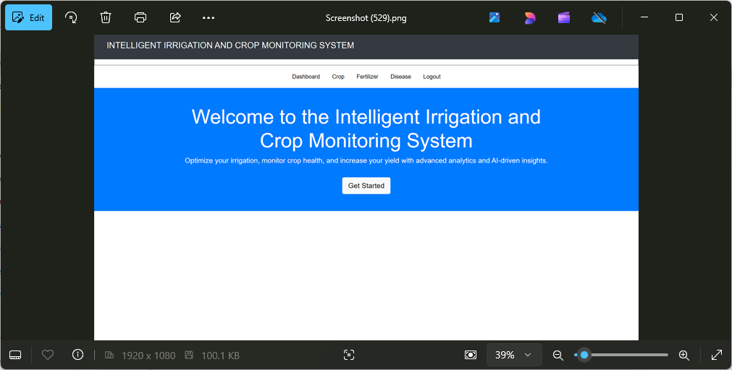
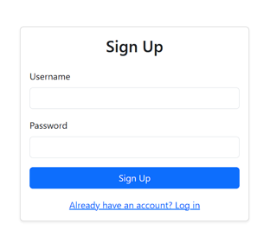
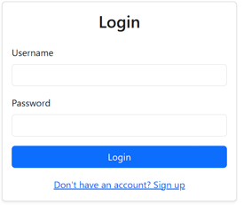
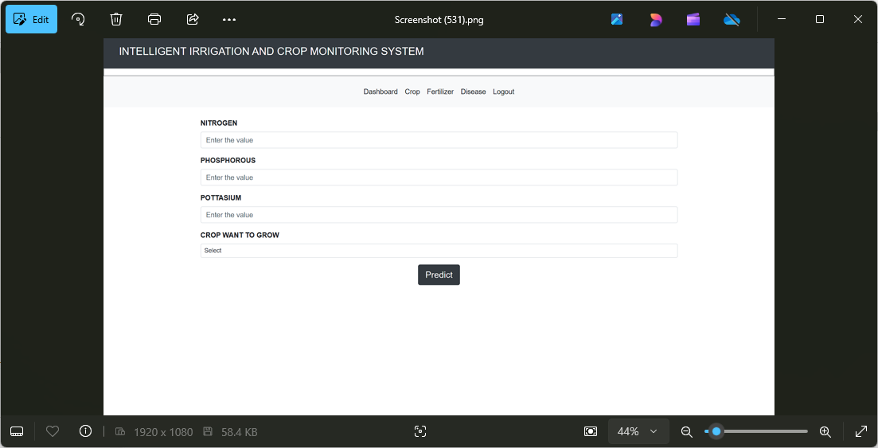
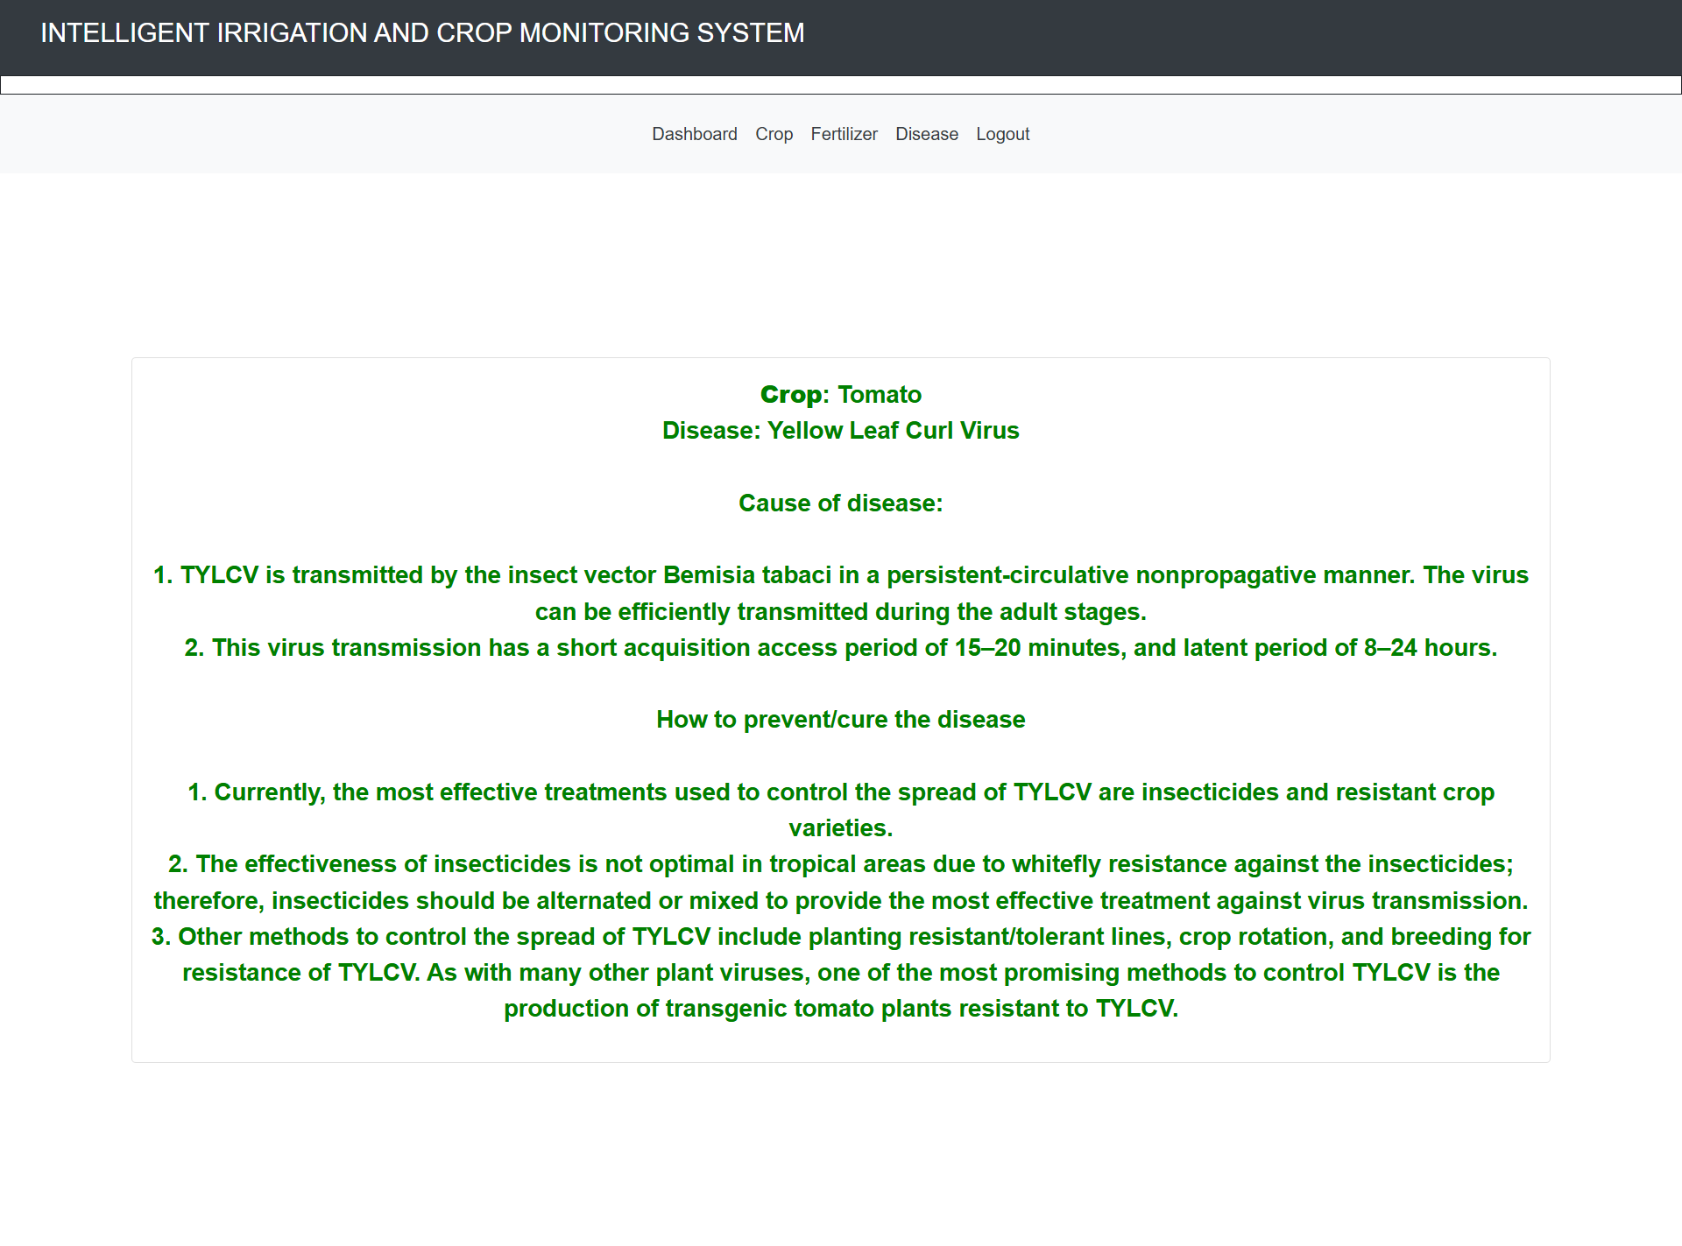
AI based crop monitoring system
Wireframe | UI
GenAI-2024-2025-B2-316
Wireframe | UI

Slide 7
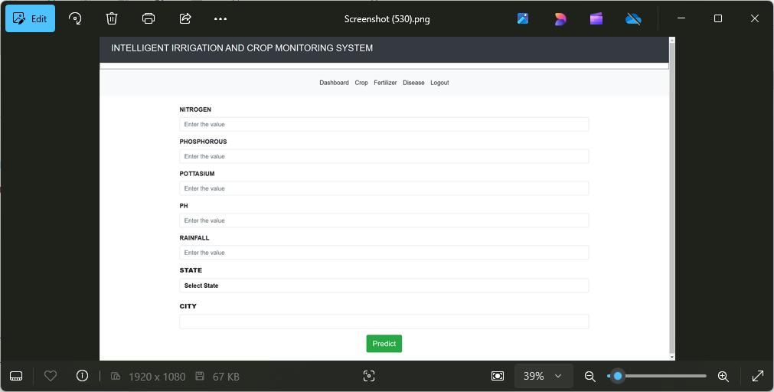
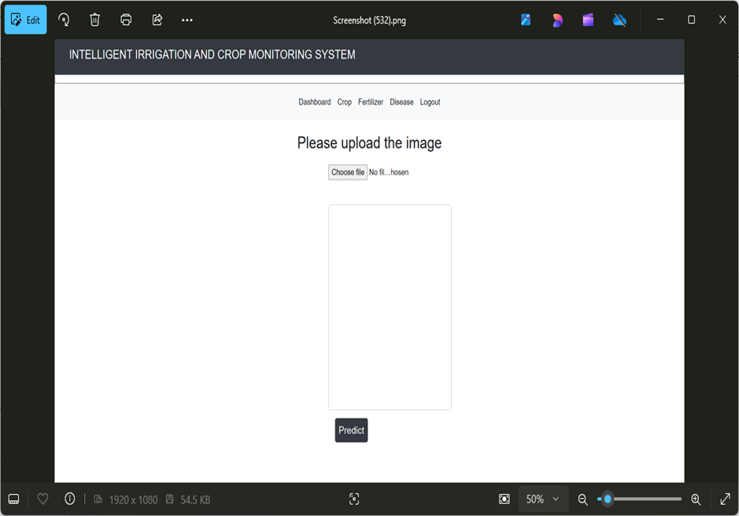
AI based crop monitoring system
Application Screenshots
GenAI-2024-2025-B2-316
Application Screenshots

Slide 8
AI based crop monitoring system
Project / Product Roadmap
GenAI-2024-2025-B2-316
Project / Product Roadmap | Milestones | Features
Short Term | Mid Term | Long Term
Crop recommendation based on soil and weather data. Fertilizer suggestions based on nutrient levels. User-friendly interface for data input. Data collection from publicly available datasets (e.g., Kaggle, government sites). | Real-time weather and soil data integration. Personalized crop management advice. Automated crop growth monitoring. Improved recommendation accuracy with more data. | AI-driven prediction of future crop yields. Sustainability and resource optimization suggestions. Integration with IoT devices for live data collection. Global expansion with multi-region crop recommendations

Slide 9
AI based crop monitoring system
Artefacts
GenAI-2024-2025-B2-316
Project Portal
Wireframe | UI
Project Portal / website is available at Link
Project wireframe / UI designs are available at Link
Presentation
Application
Project presentation (this document) is available at Link
Application is available at Link
Requirement Document / Specification
DT Playbook
Project requirement document / specification is available at Link
Project DT Playbook is available at Link
Technical Document / Specification
Overview Video
Project technical document / specification are available at Link
Project overview video is available at Link
Video provides project overview, presentations, journey wise Wireframe, UI, application demo as required and as applicable.
Source Code
Project code repository is available at Link
Note: All links are provided as clickable hyperlink available as “Link”

Slide 10
AI based crop monitoring system
Thanks
GenAI-2024-2025-B2-316
Thanks

